Slide 1
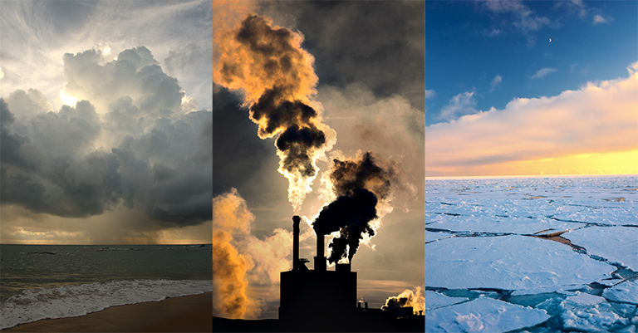
HUMAN FACTORS IMPACTING THE WATER CYCLE
We will explain how human factors impact the water cycle.
Notes:
Insert cover image and use transparency settings to fade image.

Slide 2
Do not delete this slide.
This slide is designed so that you can copy the prompt box you need and insert it into your slides.
This slide is hidden and will not be included when presenting your lesson.
TRACK WITH ME
VOCABULARY
1 -
HINT
Students, remember….
CHECK FOR UNDERSTANDING
READ WITH ME
TEACHER CUE
MAKE THE CONNECTION
Students, you already know….
EXTENSION
GESTURE WITH ME

Slide 4
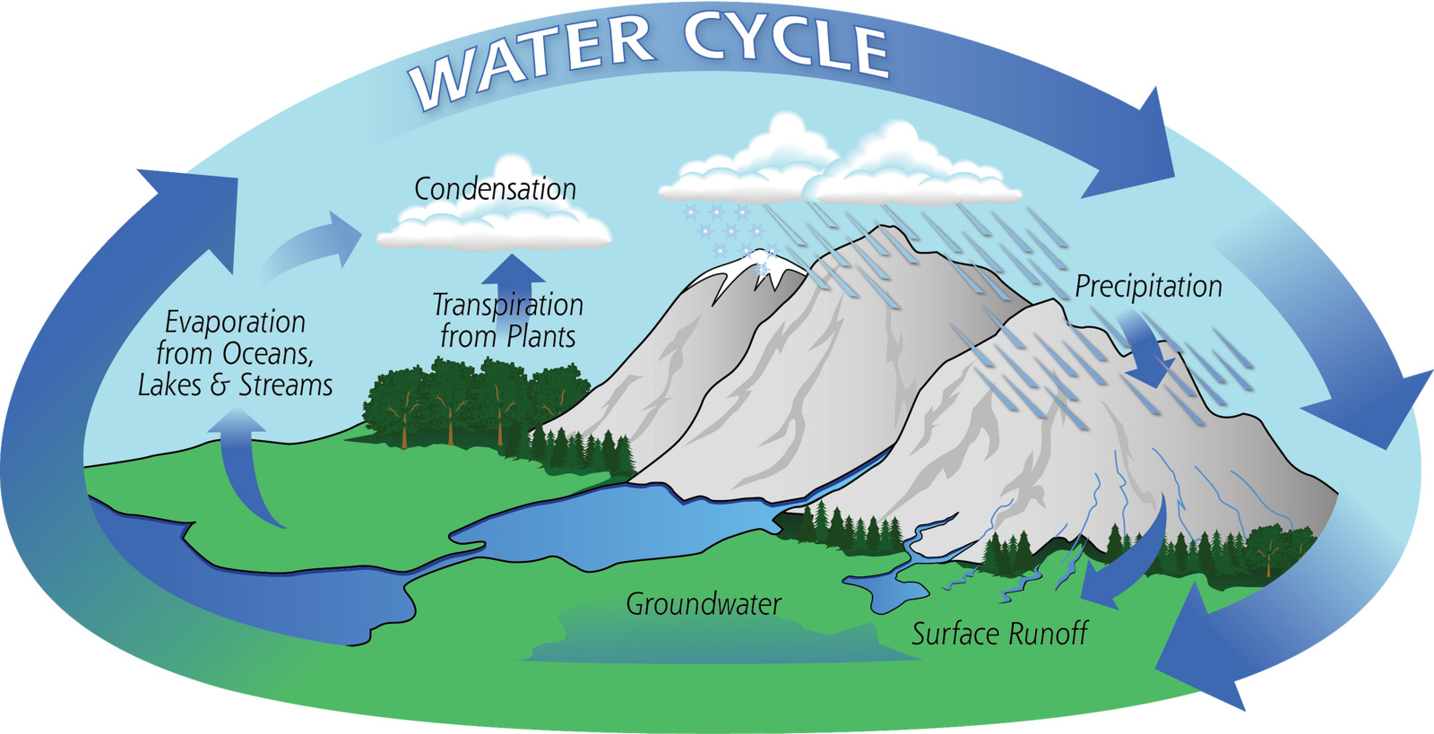
Answer these questions in full sentences
What causes evaporation in the water cycle?
2. What state is water during transpiration?

Slide 5

What is one impact of high air temperature on the water cycle?
Natural Factor | Impact on the water cycle
High air temperature | Increase evaporation of ocean water. Increases evaporation of freshwater. Increases transpiration of plants.
Low air temperature | Increases cloud formation (condensation). Increases rainfall (precipitation).

Slide 6
Repeat the opposite word/phrase.
RENEWABLE RESOURCE
IT WILL NOT RUN OUT

Slide 7
Repeat the opposite word/phrase.
NON-RENEWABLE RESOURCE
IT WILL RUN OUT

Slide 8
Repeat the opposite word/phrase.
TIMESCALE
TIME NEEDED TO COMPLETE A PROCESS

Slide 9
Repeat the opposite word/phrase.
SOLAR POWER
ENERGY FROM THE SUN

Slide 10
Repeat the opposite word/phrase.
HYDRO POWER
ENERGY FROM WATER

Slide 11
What is the difference between surface runoff and groundwater?

Slide 12
We will explain how human factors impact the water cycle.
TRACK WITH ME
READ WITH ME
We will describe how humans manage water.
We will explain how human management of water impacts the water cycle.
DECLARE THE OBJECTIVE
Read the learning objective to your partner.
Notes:
Learning Objectives contain concepts (nouns, big ideas), skills (verbs, measurable behaviours) and sometimes context (restricting or targeting conditions).
●Example: Students will be able to describe the concept of density and apply it to floating and sinking.
●
Success criteria are specific measurable outcomes that if met mean that the student has met the learning objective.
Examples:
•Students will be able to compare densities of substances using mass and volume.
•Students will be able to identify whether a solid or liquid will float or sink in a liquid based on their densities.

Slide 13
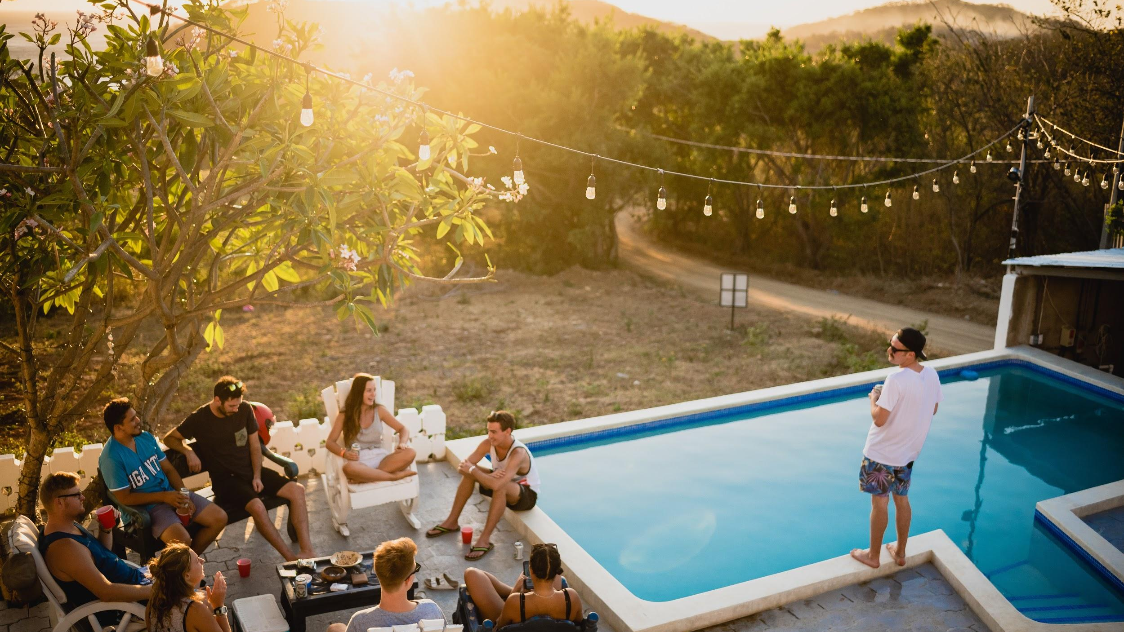
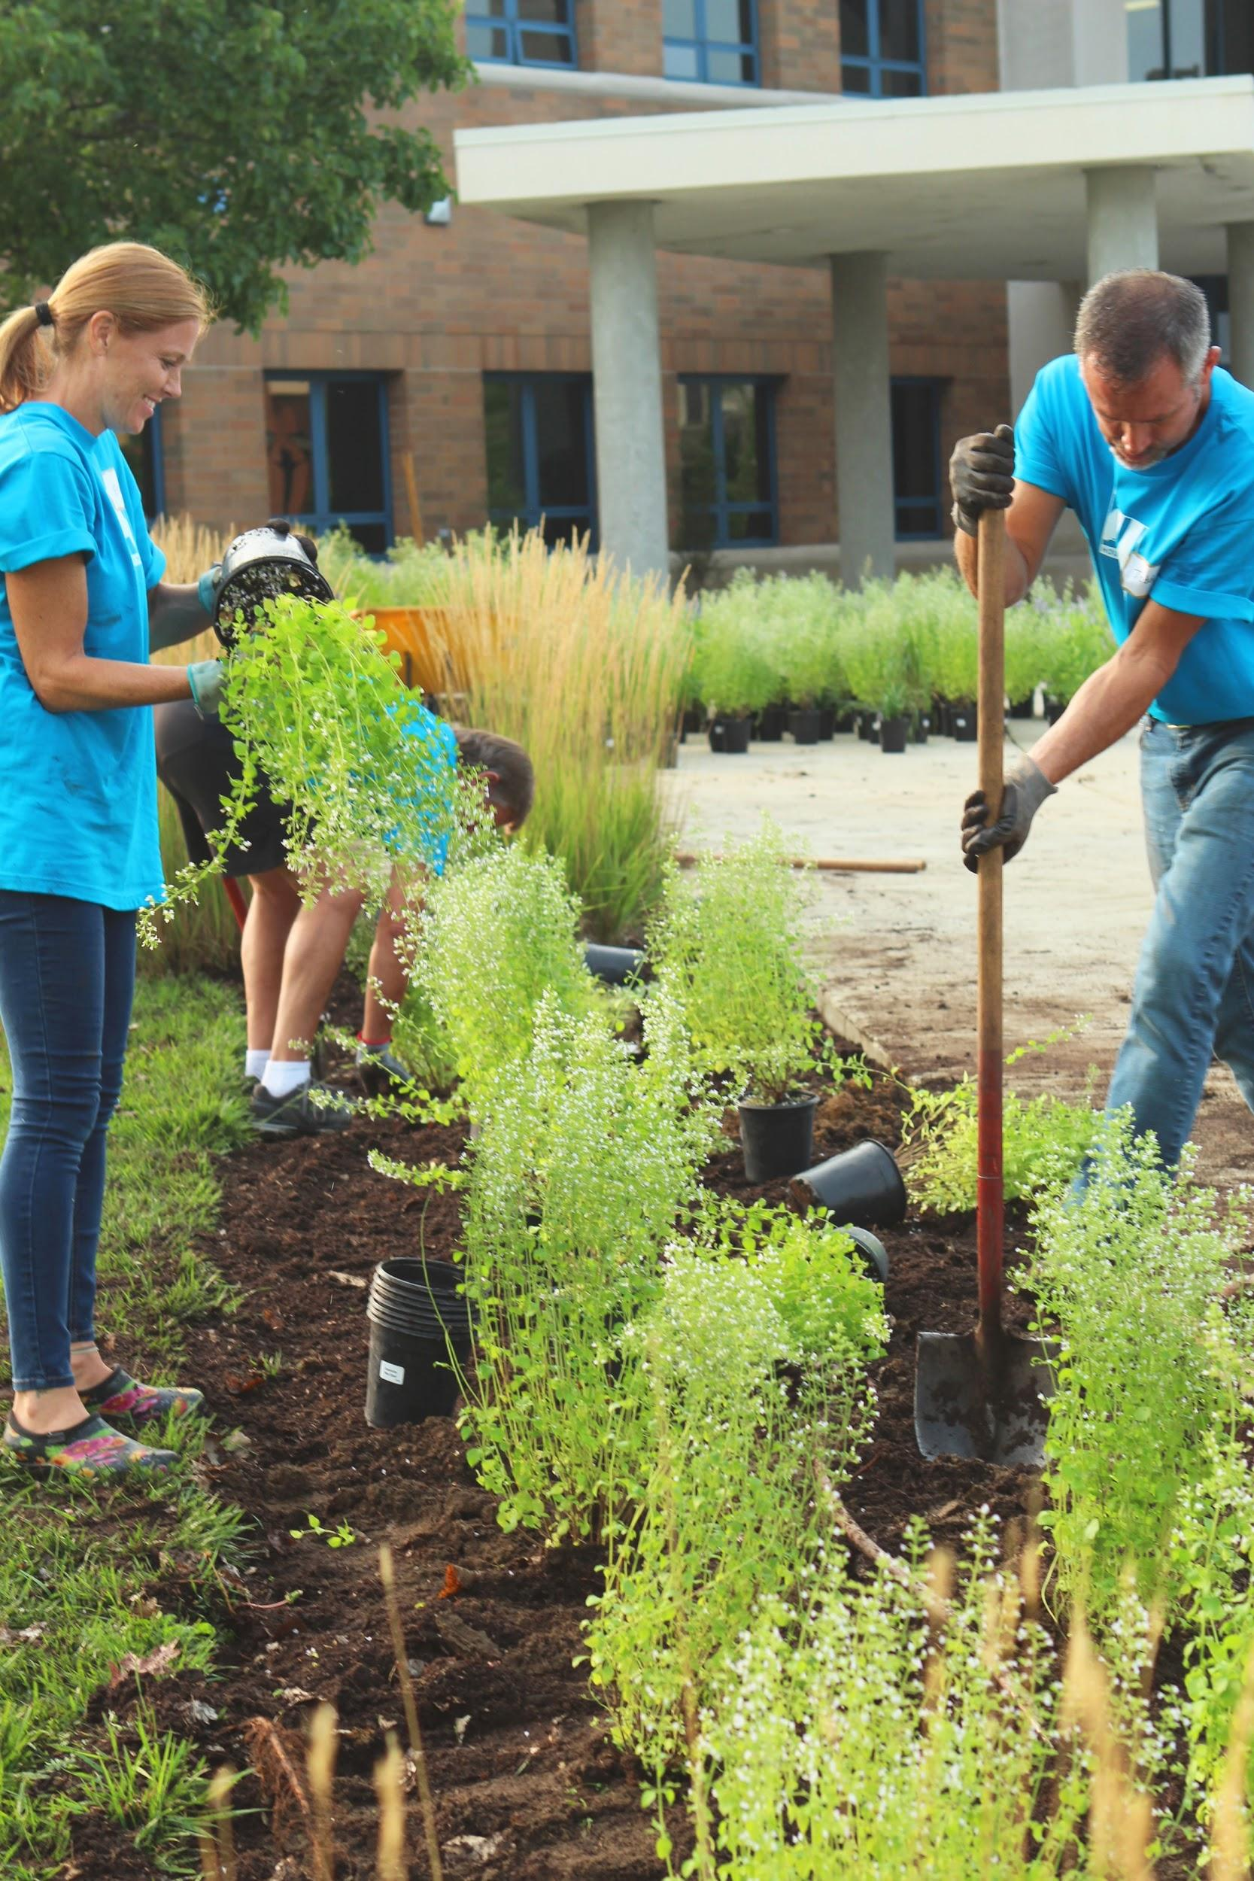
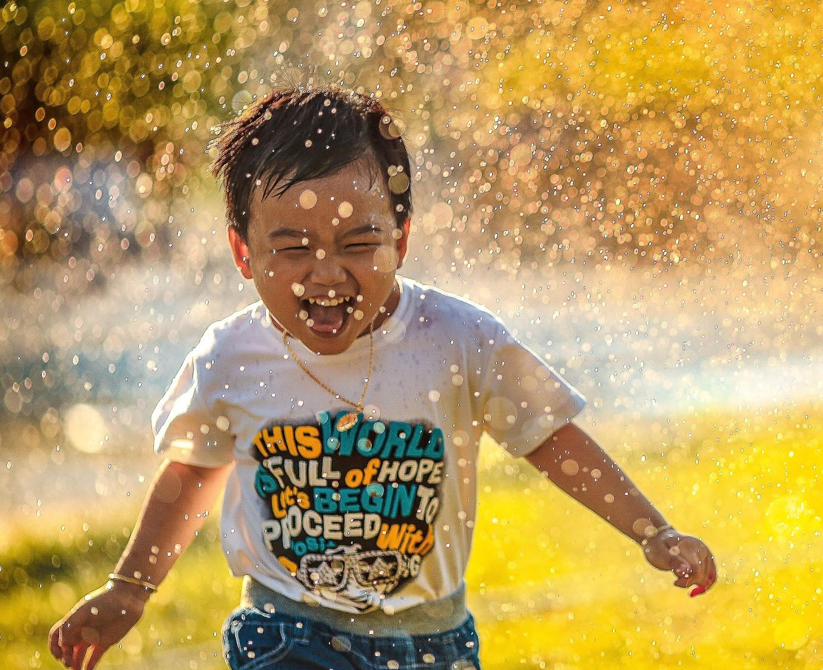
We will explain how human factors impact the water cycle.
Water is one of the most important resources in Australia.
We use it in our school for drinking, in our homes for washing and in the workplace to make materials.
Write down 3 ways you use water in your house, garden or on the weekend?
CHECK FOR UNDERSTANDING
Write down ways you use water in your house, garden or on the weekend?

Slide 14
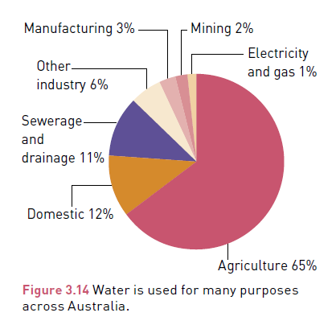
We will explain how human factors impact the water cycle.
CHECK FOR UNDERSTANDING
In the diagram below what is the highest use of water in Australia?
Human factors are events or circumstances that occur when humans manage₁ the environment.
These are 3 human factors that impact₂ the movement of water through the stages of the water cycle.
Domestic
Agriculture
Industry
Humans change the natural movement of water in the water cycle to benefit how we live.
VOCABULARY
1 - use water 2 - have an affect
Notes:
Diagram for Oxford 7 page 54

Slide 15
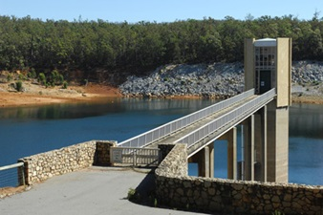
We will explain how human factors impact the water cycle.
Domestic water use, is water used in your house, outside garden and public places such as pools and ovals.
This water comes from water taps connected to groundwater and dams by underground pipes.
In Perth, large dams store water for domestic use. Using lots of stored water in your house can impact the water cycle.
CHECK FOR UNDERSTANDING
There are almost 2 million people that live in Perth. What impact does this have on domestic water use?
Serpentine dam in Perth Hills
Human Factor | Impact on the water cycle
Domestic use of water Sprinklers on sports ovals Gardening Flushing toilets Pools Cleaning | Increase water stored in dams Decrease water available in groundwater around the dam Decreases water available to native plants Decreases water in lakes, steams and rivers around the dam
Notes:
Serpentine dam: https://www.watercorporation.com.au/water-supply/our-water-sources/dams/visiting-our-dams/serpentine-dam

Slide 16
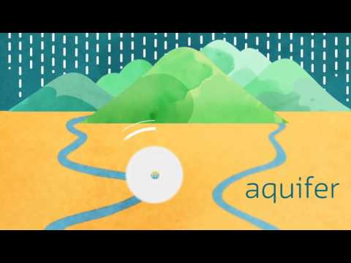
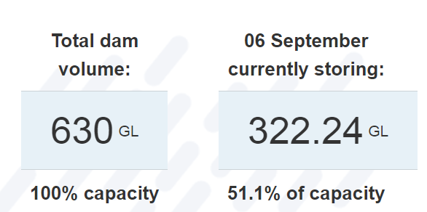
We will explain how human factors impact the water cycle.
CHECK FOR UNDERSTANDING
The image below shows Perth’s dam are only 51% (half) full. What is one factor affecting Perth’s reduction in domestic water storage?

Slide 17
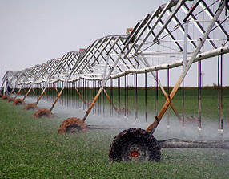
CHECK FOR UNDERSTANDING
If agricultural water demand decreases what would be a positive impact on the water cycle?
We will explain how human factors impact the water cycle.
Agriculture is the use of water to grow fruit, vegetables and grains for food. Crops such as cotton for clothes and grasses to feed animals for human food.
65% of Australian water is used for agriculture irrigation₁. 10.5 million megalitres of water were used by Australian farming in 2017-18.
Human Factor | Impact on the water cycle
Agricultural use of water Growing food Farming animals Growing grapes for wine in Margaret River | Increase demand for dam water storage Decrease water available in groundwater Decreases water available to native plants Decreases water in lakes, steams and rivers
DEFINITION
¹ Irrigation - The artificial supply of water to crops, usually by channels of sprinklers.
Notes:
Statistics from the ABS

Slide 18
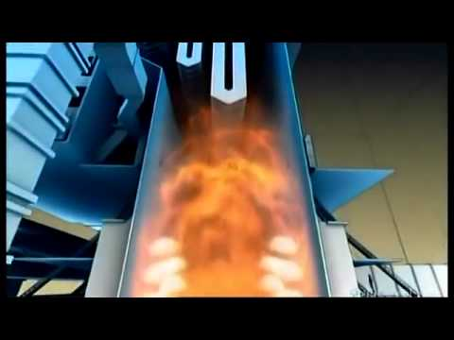
We will explain how human factors impact the water cycle.
Water used in coal fired power plant
CHECK FOR UNDERSTANDING
Where is water used in a coal fired power plant?
TEACHER CUE
Watch the first 5 minutes

Slide 19
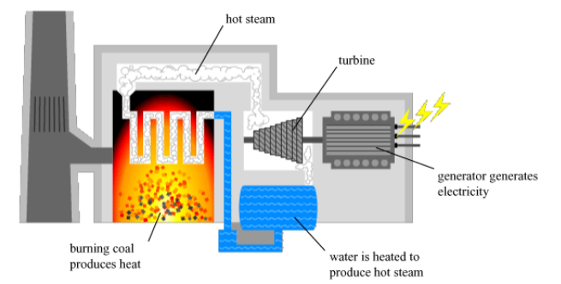
We will explain how human factors impact the water cycle.
Industry is the use of water in making products, mining rocks and generating electricity.
85% of Australian electricity is generated using a large amount of water to power a turbine₁ in a coal fired power plant. This creates excess carbon dioxide levels, causing climate change.
CHECK FOR UNDERSTANDING
What is one impact on the water cycle of using coal as an energy source?
Human Factor | Impact on the water cycle
Industry use of water Mining resources Generating electricity Making products for the shops | Increase the air temperature which increases evaporation of water from lakes and rivers Decrease in rainfall in the Perth area Increase in global temperatures from carbon dioxide causes melting polar ice caps in other parts of the world.
VOCABULARY
1 - motor that turns and makes energy

Slide 20
We will explain how human factors impact the water cycle.
HINT
Domestic water use, is water used in your house, outside garden and public places such as pools and ovals. Agriculture is the use of water to grow fruit, vegetables and grains for food. Crops such as cotton for clothes and grasses to feed animals for human food. Industry is the use of water in making products, mining rocks and generating electricity. - Increase water stored in dams. - Decrease water available in groundwater. - Decreases water available to native plants . -Decreases water in lakes, steams and rivers.
Fill in the following table.
Include one impact of each human factor.
Human Factor | Example of water use | Impact on the water cycle
Domestic | Washing dishes
Agricultural
Industry
Notes:
Finish here for DI

Slide 21
We will explain how human factors impact the water cycle.
The water cycle occurs on every area of the Earth at the same time.
Human factors impact the movement of water through the water cycle.
Humans use a lots of water in the house, garden, in agriculture and industry.
Currently Australians are using too much water and this is impacting the availability of water in other areas of the water cycle.
CHECK FOR UNDERSTANDING
What would happen the lake circled in red below if continue to store and use more water in dams for domestic use?

Slide 22
We will explain how human factors impact the water cycle.
Perth is one of the highest water using cities in Australia.
The average water use in 2017-18 per person was 123,000L.
That's a lot of water, but together we can work towards our target for 2030 and reduce water use by 15% per person.
CHECK FOR UNDERSTANDING
How does Perth’s high domestic water use impact the water cycle?
Human Factor | Impact on the water cycle
Domestic use of water Sprinklers on sports ovals Gardening Flushing toilets Pools Cleaning | Increase water stored in dams Decrease water available in groundwater around the dam Decreases water available to native plants Decreases water in lakes, steams and rivers around the dam.
Notes:
Trialing a new skills closure as an application question

Slide 23
We will explain how human factors impact the water cycle.
HINT
Domestic water use, is water used in your house, outside garden and public places such as pools and ovals. Agriculture is the use of water to grow fruit, vegetables and grains for food. Crops such as cotton for clothes and grasses to feed animals for human food. Industry is the use of water in making products, mining rocks and generating electricity. - Increase water stored in dams. - Decrease water available in groundwater. - Decreases water available to native plants . -Decreases water in lakes, steams and rivers.
Answer the following question with a full sentences.
Complete the table below.
Define a human factor?
What human factor is affecting melting ice caps?
Human Factor | Example of water use | Impact on the water cycle
Notes:
Please include tasks/questions here rather than just referring to a worksheet. This will save on photocopying and facilitate sharing with other schools.
Try and build tasks/questions which escalate through Bloom’s Taxonomy. This will help with differentiation.

Slide 24
We will explain how human factors impact the water cycle.
TRACK WITH ME
READ WITH ME
We will describe how humans manage water.
We will explain how human management of water impacts the water cycle.
CHECK FOR UNDERSTANDING
Check Success Criteria.
Notes:
Learning Objectives contain concepts (nouns, big ideas), skills (verbs, measurable behaviours) and sometimes context (restricting or targeting conditions).
●Example: Students will be able to describe the concept of density and apply it to floating and sinking.
●
Success criteria are specific measurable outcomes that if met mean that the student has met the learning objective.
Examples:
•Students will be able to compare densities of substances using mass and volume.
•Students will be able to identify whether a solid or liquid will float or sink in a liquid based on their densities.

Slide 25
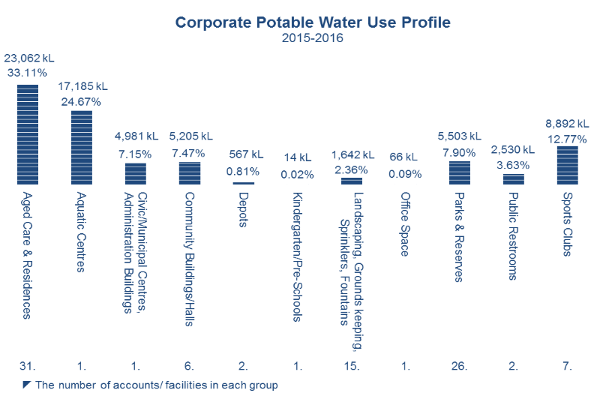
We will explain how human factors impact the water cycle.
CHECK FOR UNDERSTANDING
Notes:
Graph from http://www.belmont.wa.gov.au/Services/Environment/Pages/Water%20Use.aspx

